Slide 1
Module 5: Introducing Computer Vision
AWS Academy Machine Learning Foundations
© 2020, Amazon Web Services, Inc. or its Affiliates. All rights reserved.
Notes:
Welcome to Module 5: Introduction to Computer Vision.

Slide 2

Module overview
Sections
Introducing computer vision
Analyzing images and videos
Preparing custom datasets for computer vision
Module wrap-up
Demonstrations
Introducing Amazon Rekognition
Labeling Images with Amazon SageMaker Ground Truth
Lab
Guided Lab: Facial Recognition
Knowledge check
Notes:
This module will address the following sections:
Introduction to computer vision
Image and video analysis
Preparing custom datasets for object detection
Guided Lab: Facial Recognition
Module wrap-up
The module includes educator-led demonstrations that show you how Amazon Rekognition can evaluate images and video and how to use Amazon SageMaker Ground Truth.
Finally, you will be asked to complete a knowledge check that will test your understanding of key concepts that are covered in this module.

Slide 3
Module objectives
At the end of this module, you should be able to:
Describe the use cases for computer vision
Describe the Amazon managed machine learning (ML) services for image and video analysis
List the steps required to prepare a custom dataset for object detection
Describe how Amazon SageMaker Ground Truth can be used to prepare a custom dataset
Use Amazon Rekognition to perform facial detection
Notes:
At the end of this module, you should be able to:
Describe the use cases for computer vision
Describe the Amazon managed ML services available for image and video analysis
List the steps required to prepare a custom dataset for object detection
Describe how Amazon SageMaker Ground Truth can be used to prepare a custom dataset
Use Amazon Rekognition to perform facial detection

Slide 4
Section 1: Introducing computer vision
Module 5: Introducing Computer Vision
Notes:
Introducing Section 1: Introduction to computer vision.

Slide 5
Computer vision overview
Computer vision is the automated extraction of information from digital images.
Notes:
Computer vision is an exciting space in machine learning. The advances in computing power and algorithms over the last 10 years have led to an increase in capabilities and easier access to computer vision technologies.
You can think of computer vision as the automated extraction of information from digital images.
Computer vision enables machines to identify people, places, and things in images with accuracy at or above human levels, with greater speed and efficiency. Often built with deep learning models, computer vision automates the extraction, analysis, classification, and understanding of useful information from a single image or a sequence of images. The image data can take many forms, such as single images, video sequences, views from multiple cameras, or three-dimensional data.

Slide 6






Computer vision applications
Public safety
and home security
Authentication and enhanced
computer-human interaction
Content management
and analysis
Autonomous driving
Medical imaging
Manufacturing process control
Notes:
Some of the primary use cases for computer vision include these examples.
Public safety and home security
Computer vision with image and facial recognition can help to quickly identify unlawful entries or persons of interest. This process can result in safer communities and a more effective way of deterring crimes.
Authentication and enhanced computer-human interaction
Enhanced human-computer interaction can improve customer satisfaction. Examples include products that are based on customer sentiment analysis in retail outlets or faster banking services with quick authentication that is based on customer identity and preferences.
Content management and analysis
Millions of images are added every day to media and social channels. The use of computer vision technologies—such as metadata extraction and image classification—can improve efficiency and revenue opportunities.
Autonomous driving
By using computer-vision technologies, auto manufacturers can provide improved and safer self-driving car navigation, which can help realize autonomous driving and make it a reliable transportation option.
Medical imaging
Medical image analysis with computer vision can improve the accuracy and speed of a patient's medical diagnosis, which can result in better treatment outcomes and life expectancy.
Manufacturing process control
Well-trained computer vision that is incorporated into robotics can improve quality assurance and operational efficiencies in manufacturing applications. This process can result in more reliable and cost-effective products.

Slide 7
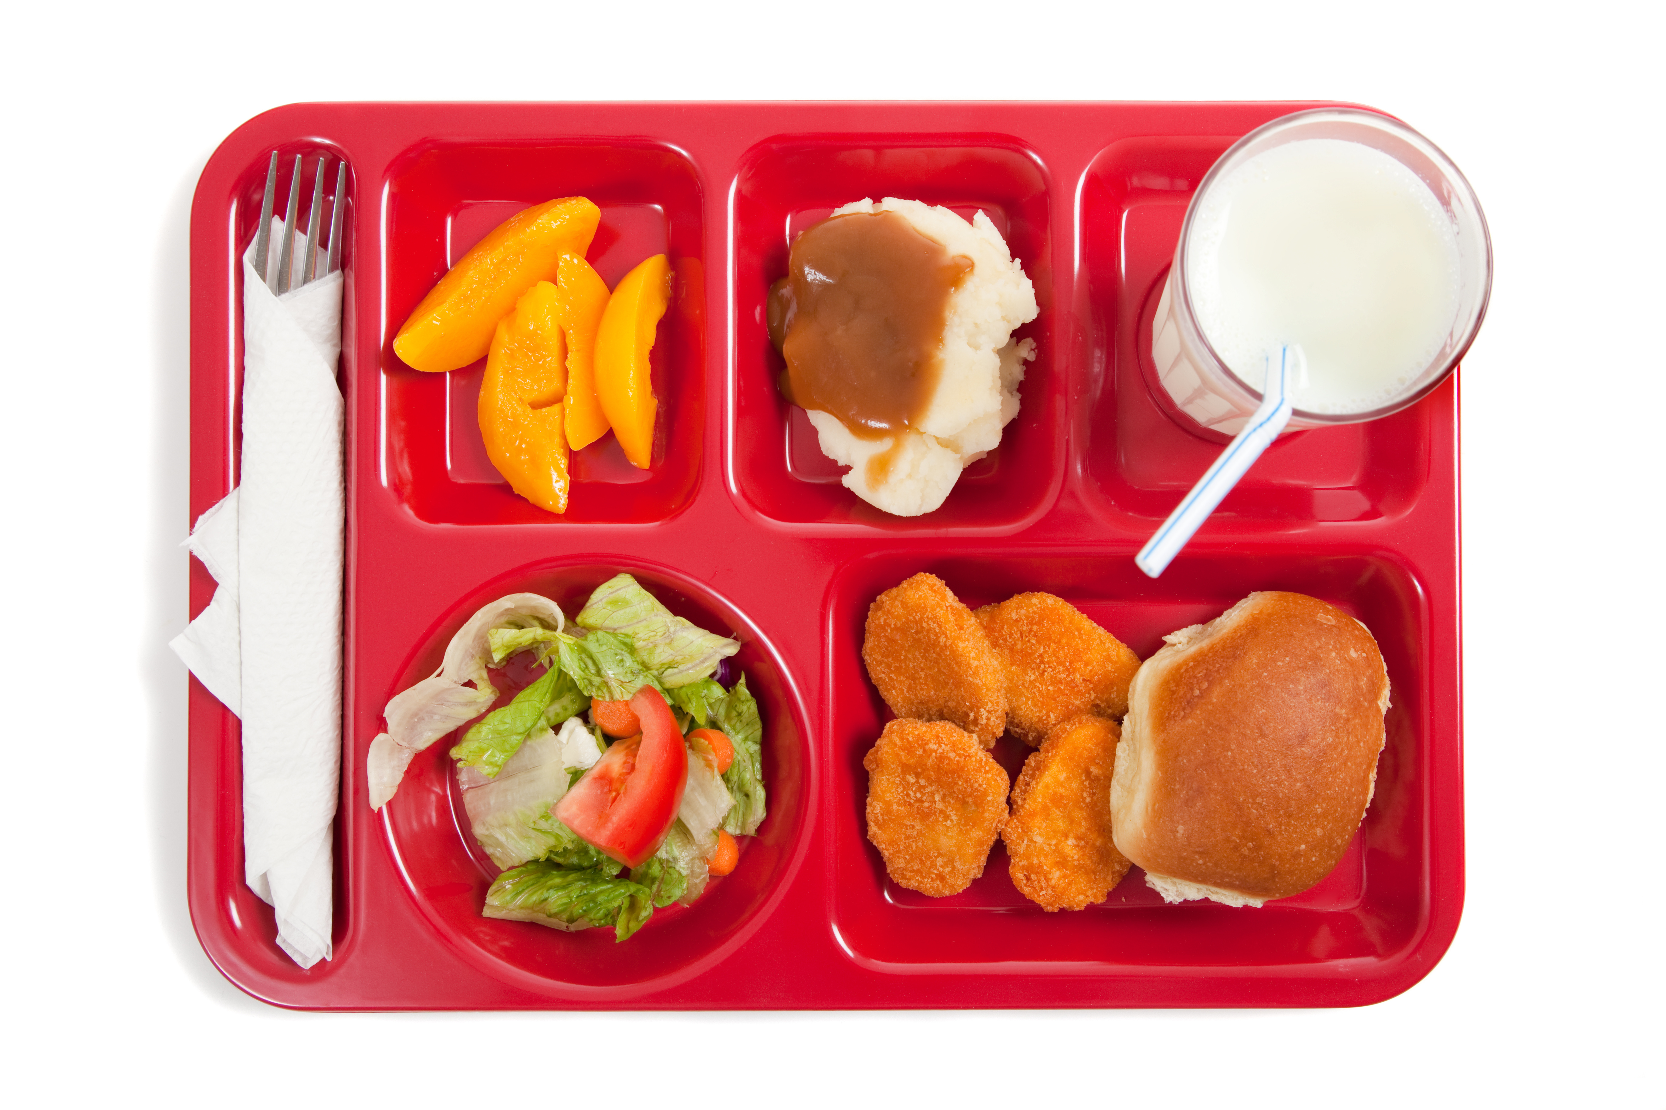
Computer vision problems
Content recognition
Image analysis
Object classification
Food?
Breakfast?
Lunch?
Dinner?
Notes:
Classification in machine learning is used to decide which category or categories that a picture or object belongs to. This process is no different than any other classification problem for machine learning.
In the picture here, what is represented? Is it breakfast, lunch, or dinner? Would the classification only be food?
The answer depends on the model that you use to perform the classification. Models must be trained, and the training data provides the algorithm with the data to learn from.
Say that you have a model that was trained with pictures of different types of food. You might expect a result that the image outputs categories of Milk, Cookie, Orange, Hamburger (or is it beef burger, or a vegetarian burger?), Salad, and French Fries. If you trained the model with different images, you might have classified the objects in the image as Tray, Cutlery, and Napkin.
When you have multiple classes, this is known as a multi-class classification problem. When you have only two classes, this is known as a binary classification problem.

Slide 8
Computer vision problems
Confidence
Content recognition
Image analysis
Object classification
Object detection
Milk | 97.1
Peaches | 92.3
Ice Cream | 97.1
Salad | 69.5
Nuggets | 77.5
Bread Roll | 94.5
Bounding boxes
(top,left,width,height)
Notes:
When you work with images, you might want to know both what kind of objects are in the image and the locations of those objects.
Object detection provides the categories of the image and the location of the objects in the image. The location is provided by a set of coordinates for a box that surrounds the image, which is known as the bounding box.
Bounding boxes for object detection typically provide top, left, width, and height coordinates that surround the images. You can use these coordinates in your applications.
When objects are detected in an image, a confidence number is usually associated with that object. This percentage indicates how probable it is that the object belongs to a specific class. This confidence level is important when you want to determine an action that is based on object detection, especially in applications that use facial detection.

Slide 9
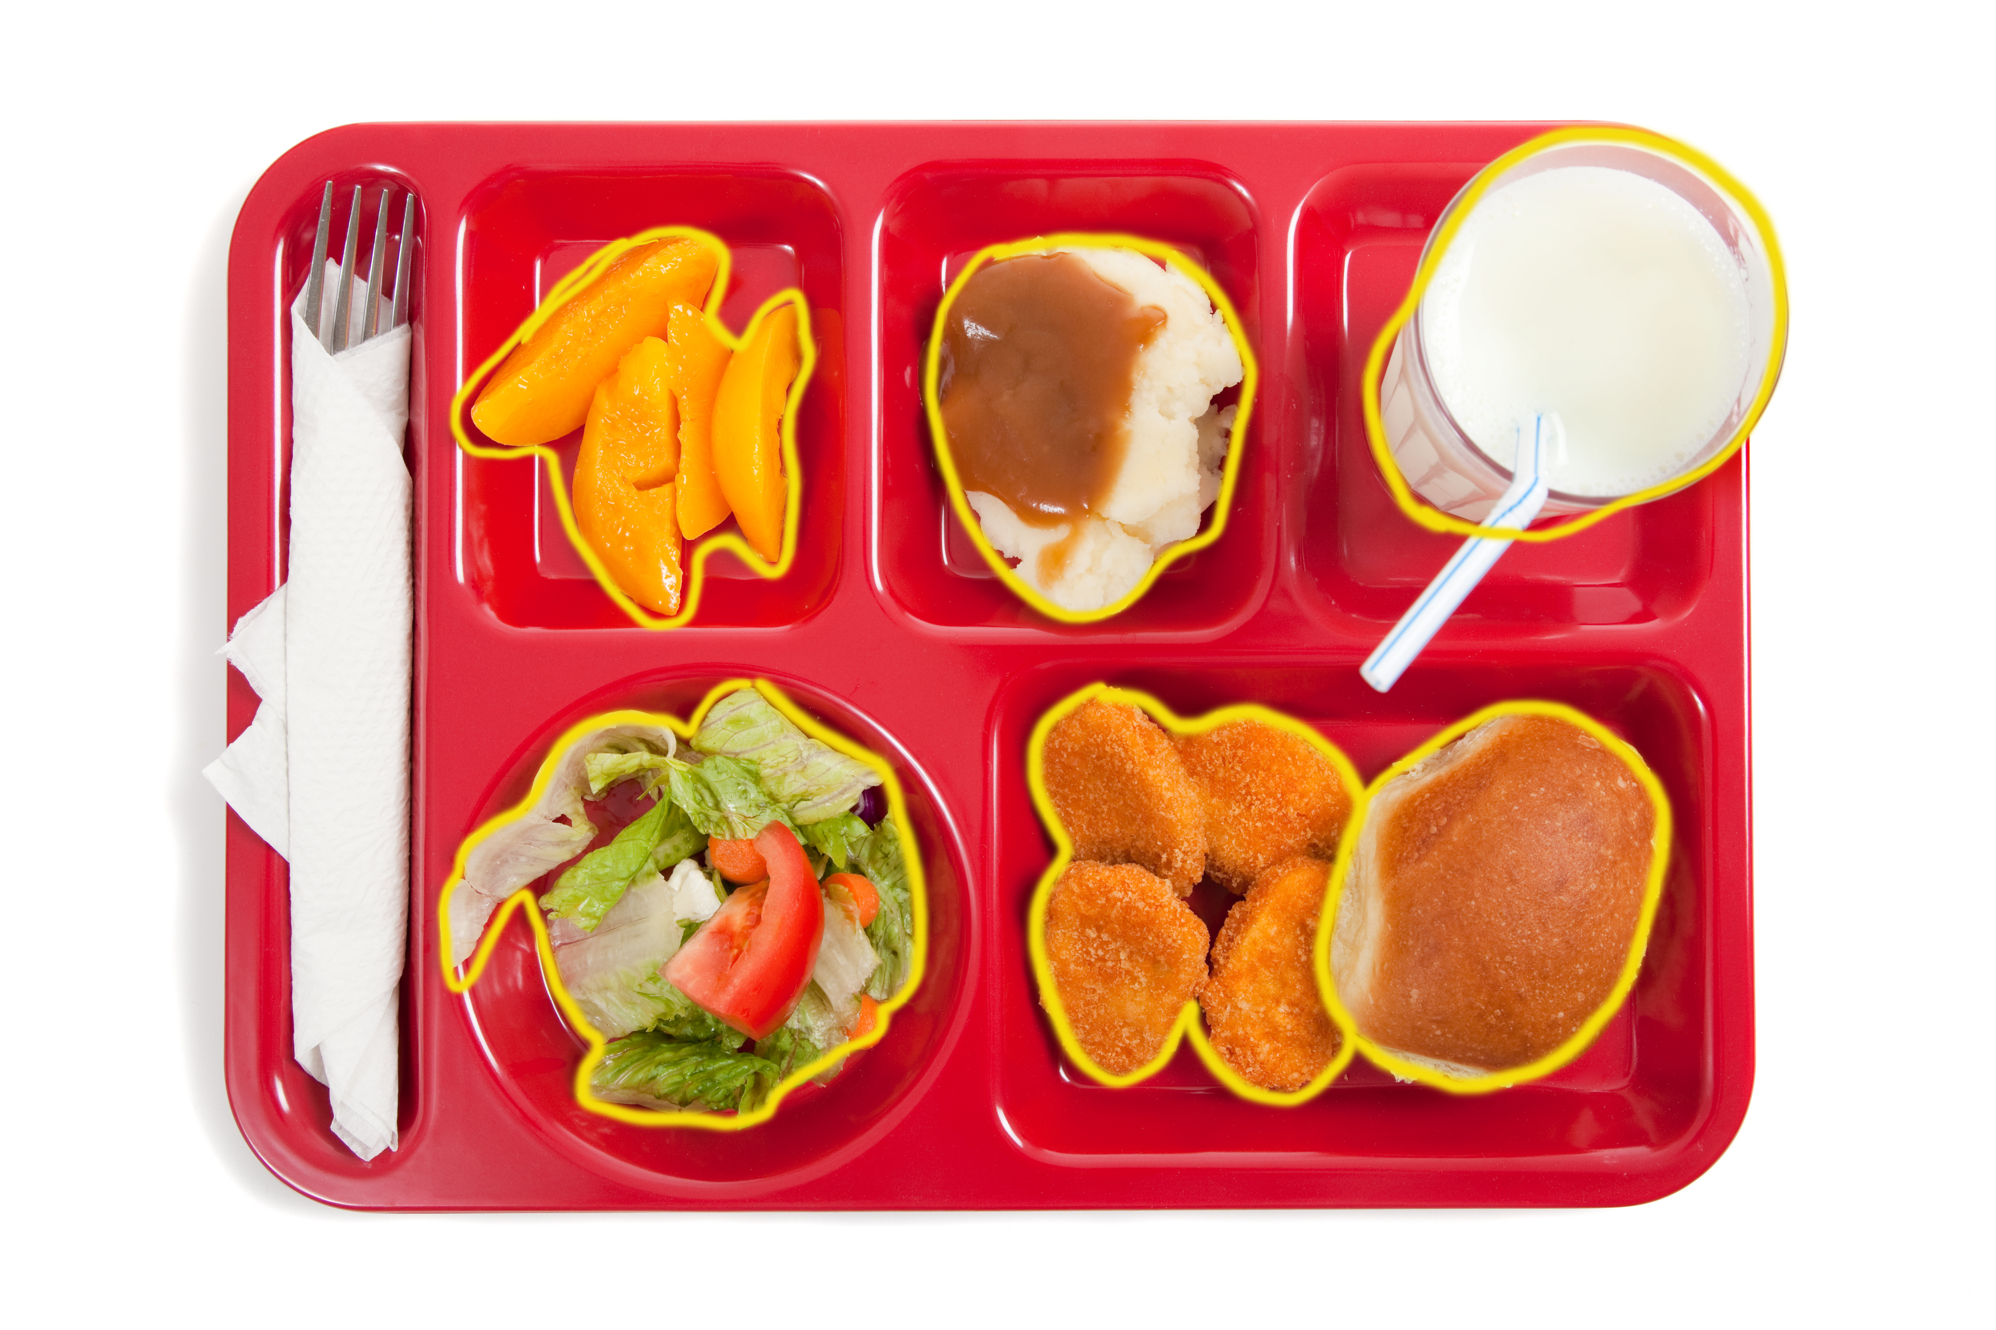
Computer vision problems
Content recognition
Image analysis
Object classification
Object detection
Object segmentation
Milk
Peaches
Ice Cream
Salad
Nuggets
Bread Roll
Notes:
At the time of writing, object segmentation (also known as semantic segmentation) is a key problem in the field of computer vision. Object segmentation is similar to object detection, but you go into more detail to get fine boundaries for each detected object. It is a fine-grained inference for predicting each pixel in the image.
Applications that require object segmentation include autonomous vehicles and advanced computer-human interactions. Object segmentation is not covered in this course.

Slide 10
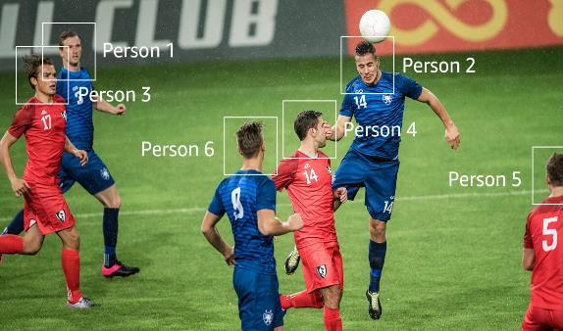
Computer vision use cases
Content recognition
Video analysis
Instance tracking
Pathing – You can capture the path of people in the scene. For example, you can use the movement of athletes during a game to identify plays for post-game analysis.
Notes:
With Amazon Rekognition Video, you can capture the position of each person in a video. The TrackPersons operation detects people and how they move, even when the camera is in motion. It can also attribute motion to the same person when their face is blocked or if they move in and out of the frame. The TrackPersons operation returns time segments and confidence scores.

Slide 11
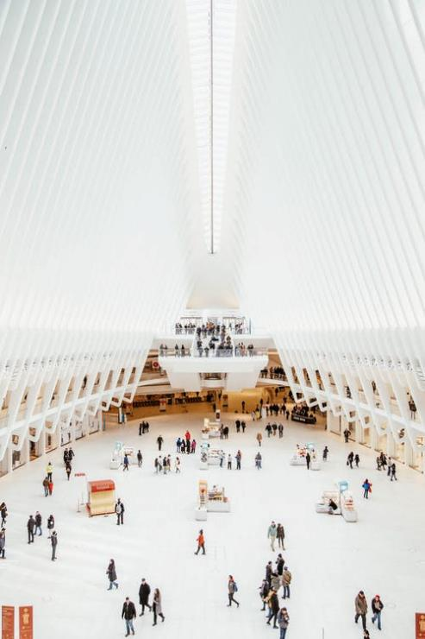

Computer vision use cases
Content recognition
Video analysis
Instance tracking
Action recognition
Analyze shopper behavior and density in your retail store by studying the path that each person follows
Notes:
You can analyze shopper behavior and density in your retail store by studying the path that each person follows. By using face analysis, you can also understand the average age ranges, gender distribution, and emotions expressed by the shoppers without identifying them.

Slide 12

Computer vision use cases
Content recognition
Video analysis
Instance tracking
Action recognition
Motion estimation
Notes:
Amazon Rekognition Video enables you to automatically identify thousands of objects. Example objects might include vehicles or pets; scenes like a city, beach, or wedding; and activities like delivering a package or dancing. Amazon Rekognition Video relies on motion in the video to accurately identify complex activities, such as blowing out a candle or extinguishing fire.
Some examples from the image might include:
Capturing the batter’s accuracy, the pitcher’s pitching style, the type of pitch (slow ball, slider, and others), the inning, and the batter’s performance versus the specific pitcher. All that data could (and does!) get used by managers to coach players on how to improve their performance. Coaches can also use the data during the game to make game-time decisions.
Initiating various actions based on the speed of the ball leaving the bat and its trajectory. A hit that is calculated by an ML model could lead to:
An audio or visual warning about a possible foul ball into the crowd.
A preemptive alarm that a hit has a high probability of being a home run. This would enable events that follow a homerun to be well-timed and automated (such as music or fireworks when the homerun is hit by the home team).

Slide 13
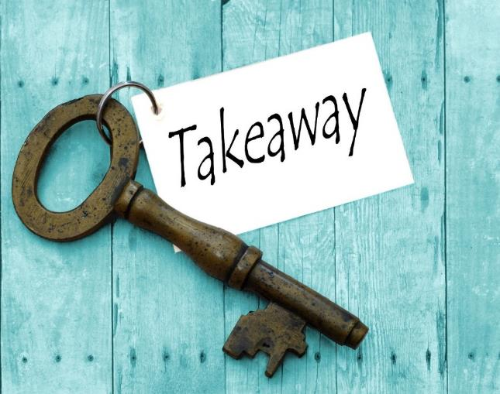
Section 1 key takeaways
Computer vision is the automated extraction of information from images
Image analysis includes object classification, detection, and segmentation
Video analysis includes instance tracking, action recognition, and motion estimation
Notes:
Some key takeaways from this section of the module include:
Computer vision is the automated extraction of information from images
From a practical point of view, you can divide computer vision into two distinct areas—image analysis and video analysis
Image analysis includes object classification, detection, and segmentation
Video analysis includes instance tracking, action recognition, and motion estimation

Slide 14
Section 2: Analyzing images and videos
Module 5: Introducing Computer Vision
Notes:
Introducing Section 2: Analyzing images and videos.

Slide 15
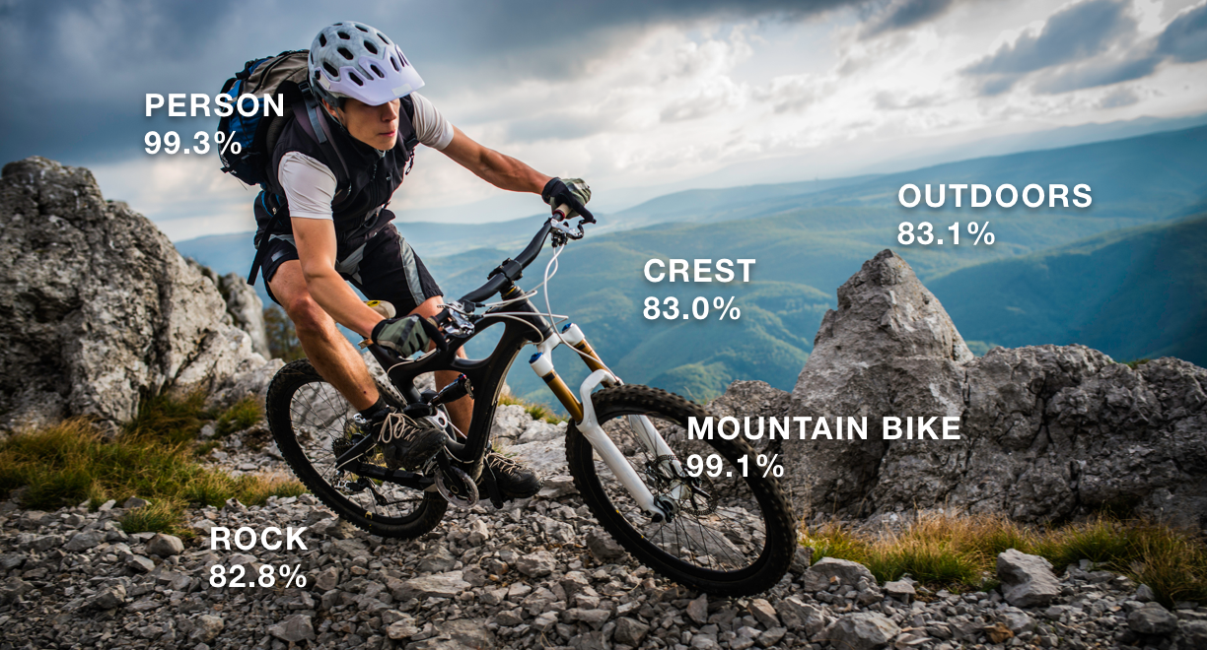
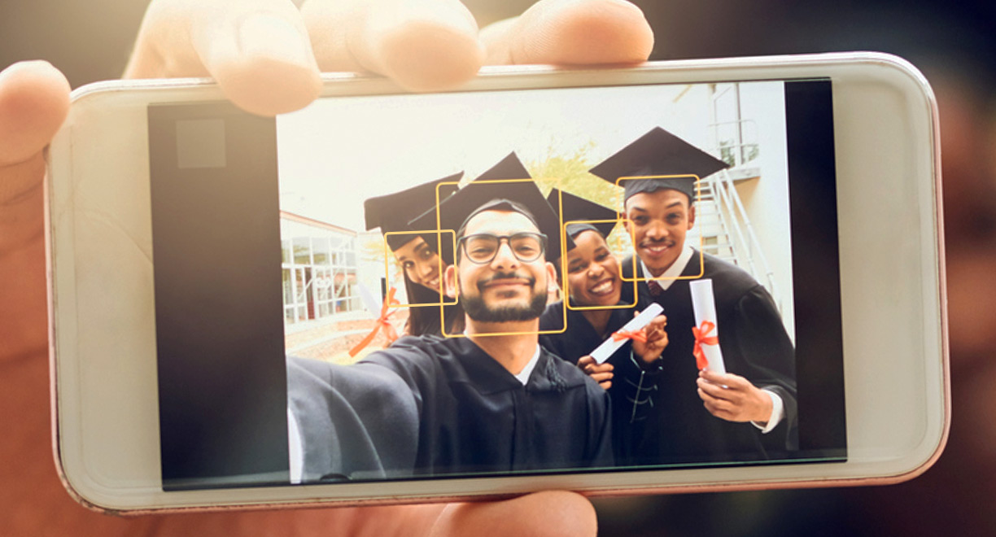

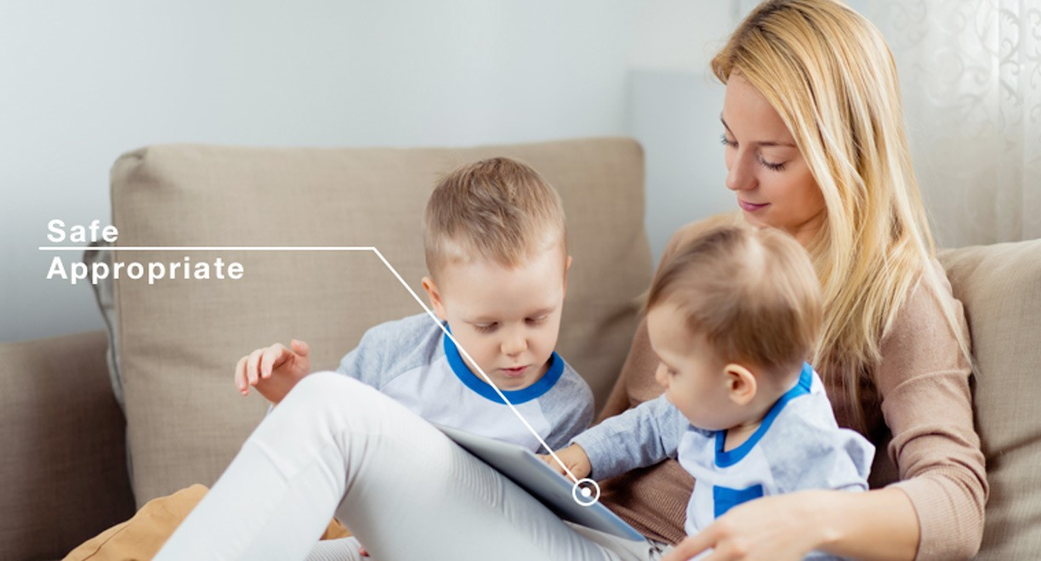
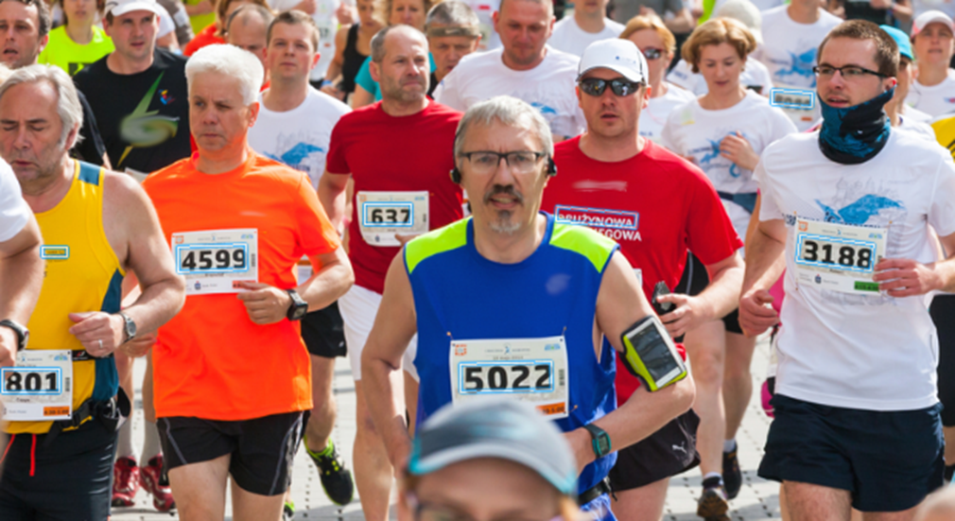
Amazon Rekognition
Managed service for image and video analysis
Types of analysis
Searchable image and video libraries
Face-based user verification
Sentiment and demographic analysis
Unsafe content detection
Text detection
Security and compliance
Notes:
Amazon Rekognition is a computer vision service based on deep learning. You can use it to add image and video analysis to your applications.
Amazon Rekognition enables you to perform the following types of analysis:
Searchable image and video libraries – Amazon Rekognition makes images and stored videos searchable so that you can discover the objects and scenes that appear in them.
Face-based user verification – Amazon Rekognition enables your applications to confirm user identities by comparing their live image with a reference image.
Sentiment and demographic analysis – Amazon Rekognition interprets emotional expressions, such as happy, sad, or surprise. It can also interpret demographic information from facial images, such as gender.
Unsafe content detection – Amazon Rekognition can detect inappropriate content in images and in stored videos
Text detection – Amazon Rekognition Text in Image enables you to recognize and extract text content from images.
You need to check if the applications you build using Amazon Rekognition would fall under any regulatory restrictions as defined within your field or country. Security and compliance for Amazon Rekognition is a shared responsibility between AWS and the customer. For more information, see the AWS Compliance page (https://aws.amazon.com/compliance/)

Slide 16



Amazon Rekognition
Can add powerful visual analysis to your application
Is highly scalable and continuously learns
Integrates with other AWS services
Languages supported by the Amazon Rekognition SDKs:
JavaScript
Python
PHP
.NET
Ruby
Java
Go
Node.js
C++
Notes:
Amazon Rekognition is an AWS managed service that enables you to integrate image and video analysis into your applications. Because it’s a managed service, Amazon Rekognition hosts the machine learning models, maintains an API, and scales out to meet demand for you. You also benefit from a set of models that constantly learn and improve. It integrates with other AWS services, such as Amazon S3 for storage and AWS Identity and Access Management (IAM) for authentication and authorization. You only need to focus on building applications that use the API and, optionally, training the service to understand your unique business requirements.
Amazon Rekognition provides APIs, SDKs, and AWS Command Line Interface (AWS CLI) commands. You can use these resources to access and interact with Amazon Rekognition. The languages that the SDKs support include JavaScript, Python, PHP, .NET, Ruby, Java, GO, Node.js, and C++.

Slide 17
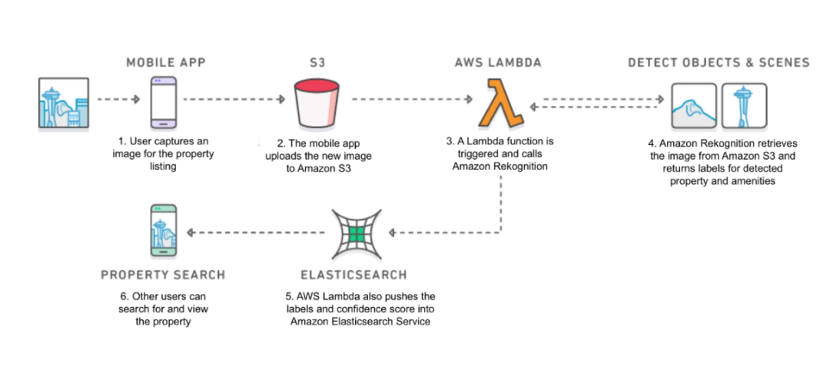





Use case 1: Searchable image library
1
2
3
4
Mobile App
Amazon S3
AWS Lambda
Amazon Rekognition
6
5
Mobile App
Amazon Elasticsearch Service
Notes:
The diagram illustrates an image search capability where users can take pictures and receive information about the real estate properties that they are viewing.
The user takes a picture using their mobile device. The user then initiates a search, which causes the application to upload to Amazon S3.
Amazon S3 is configured to call other services when a write event occurs. In this case, the bucket passes the S3 path of the new object to AWS Lambda.
When the Lambda function is called, it uses the Amazon Rekognition SDK to call the service.
Amazon Rekognition analyzes the image, detects aspects of the property, creates labels, and passes the information back to Lambda as a JavaScript Object Notation (JSON) object.
Lambda then stores the labels and confidence score in Amazon Elastic Search.
Application users can now identify aspects of a property by using the objects that are detected in the image.

Slide 18


Use case 2: Image moderation
1
2
3
Users
Amazon S3
AWS Lambda
Amazon Rekognition
6
Inappropriate
content
detected
Appropriate
content
detected
5
4
Manual Review
Pictures Posted
Notes:
In this example architecture, the system checks uploaded images for inappropriate content. Like the previous example, processing begins when the user uploads content.
The user uploads an image to Amazon S3.
The S3 bucket is configured to call a Lambda function when an object is written to the bucket.
Lambda calls Amazon Rekognition via the SDK. Amazon Rekognition analyzes the images for inappropriate content and sends the response back to Lambda.
If the content is appropriate, the content is approved.
If the content is not appropriate, the content can be sent for manual inspection.
If not approved, notification is sent to the user.

Slide 19
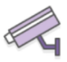




Use case 3: Sentiment analysis
1
2
3
In-store camera
Amazon Kinesis
Video Streams
Amazon Rekognition
Amazon Kinesis
Data Streams
4
7
6
5
Amazon QuickSight
Amazon Redshift
Amazon S3
AWS Lambda
Notes:
In this final use case, the system analyzes a video feed for sentiment analysis.
.
An in-store camera captures video that is sent to a back office or a cloud-based application. Typically, an application like this will use Amazon Kinesis to stream the video.
The application uses the Amazon Rekognition SDK to send the video to Amazon Rekognition for further analysis. Visual sentiment is extracted, along with other attributes such as age, visual gender etc.
The discovered attributes are sent to Amazon Kinesis.
A Lambda function extracts the data from the stream.
Data is written to S3.
Periodically the data is loaded into Redshift.
Reports can be generated from the data in tools such as Amazon QuickSight.

Slide 20

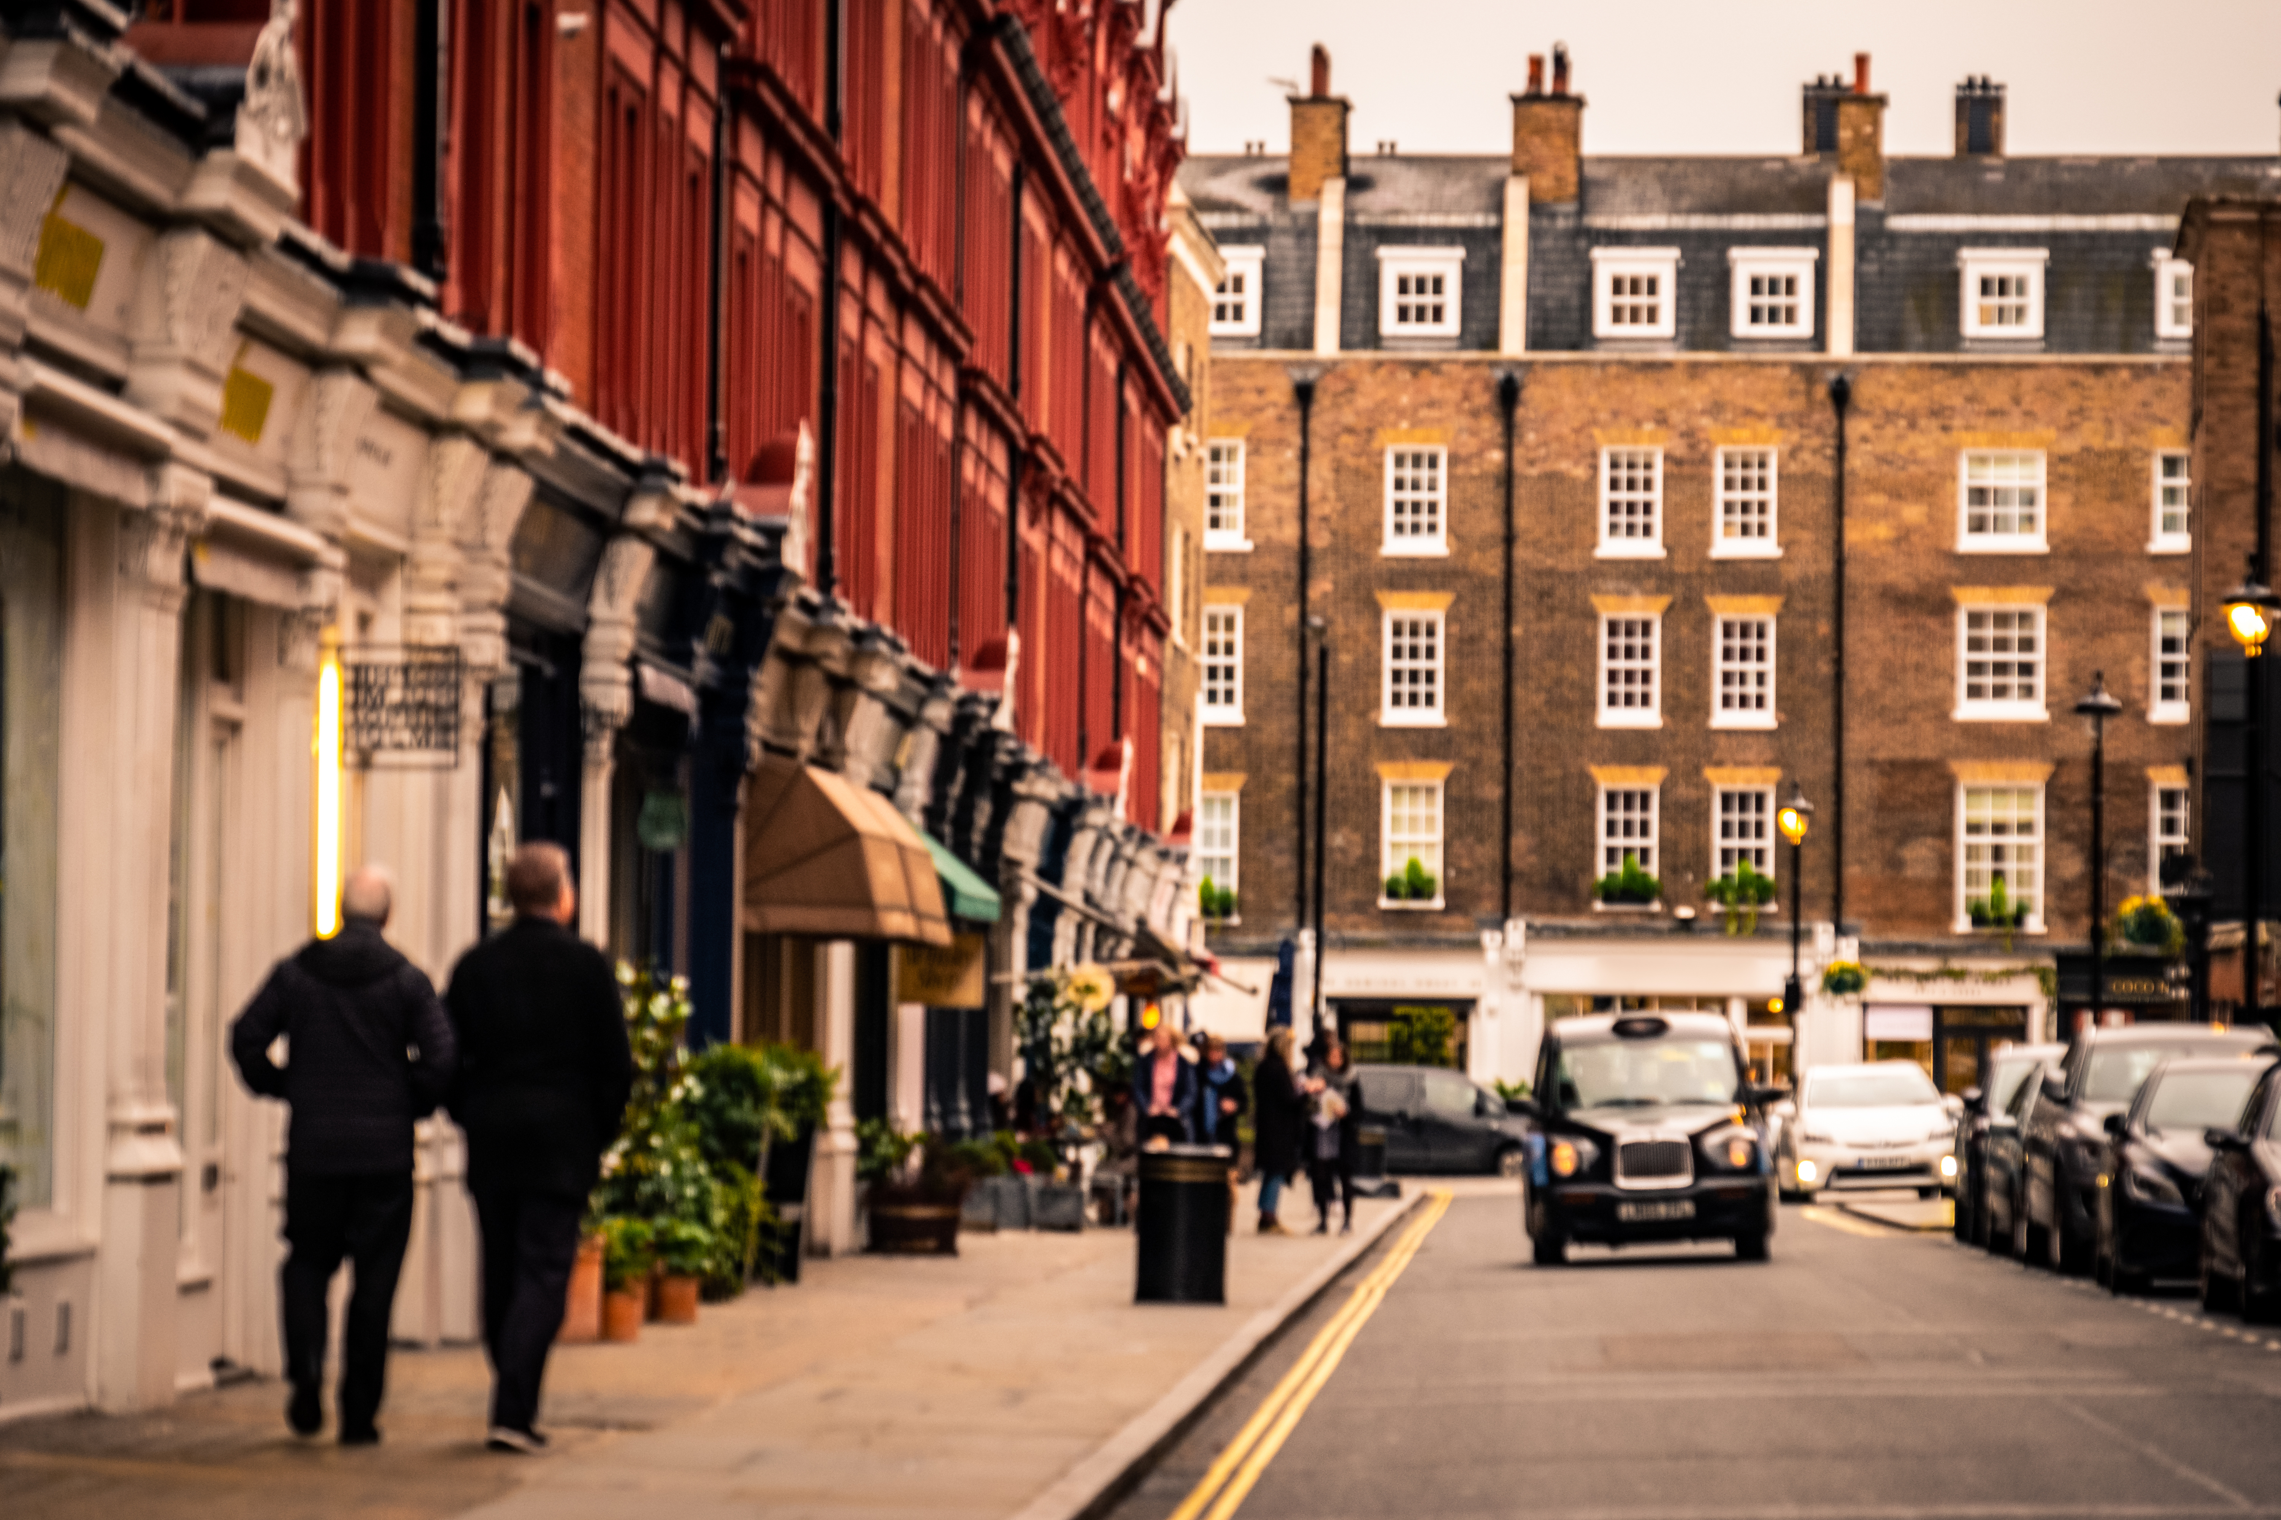

Using Amazon Rekognition
API operations
Detect Labels
Detect Faces
Recognizing Celebrities
Detecting Unsafe Images
JSON results
"Name": "Car",
"Confidence": 96.9476089477539,
"Instances": [
{
"BoundingBox": {
"Width": 0.07903634756803513,
"Height": 0.08699918538331985,
"Left": 0.7790974974632263,
"Top": 0.6977462768554688
},
"Confidence": 96.9476089477539
}
S3 bucket
01100110
Byte stream
Amazon Rekognition
Image.jpg
Notes:
Amazon Rekognition is designed to integrate into your applications via the API and SDKs.
API operations are provided for detecting labels, faces, recognizing celebrities, and detecting unsafe images.
To perform a prediction, you must provide the service either an image object in Amazon S3, or upload a byte steam of an image. Images can be JPEG or PNG formats.
Amazon Rekognition processes the image, performs the prediction, and returns a JSON object with the results.

Slide 21
Image analysis: Object and scene detection
Person
98.9%
Car
97.9%
Architecture
92.2%
Building
97.6%
Pedestrian
90.6%
Downtown
95.6%
City
97.6%
Road
93.0%
Street
93.0%
Urban
97.6%
Notes:
When Amazon Rekognition performs predictions, it often returns multiple labels. Each label has a confidence level. This confidence level indicates how likely the label was found in the image.
Like this example shows, labels can also have hierarchies.

Slide 22
Image analysis: Object and scene detection
"Name": "Car",
"Confidence": 96.9476089477539,
"Instances": [
{
"BoundingBox": {
"Width": 0.07903634756803513,
"Height": 0.08699918538331985,
"Left": 0.7790974974632263,
"Top": 0.6977462768554688
},
"Confidence": 96.9476089477539
}
x = imageHeight * BoundingBox[“Left”]
y = imageWidth * BoundingBox[“Top”]
Notes:
When you find instances of objects, you must understand where in the image the detected object is. The results from Amazon Rekognition for each instance include a bounding box that contains the starting coordinate (Top, Left) and box dimensions (Width, Height). Like the example, you can use this information to determine the location of the detected object in the image.
It’s important to note that all findings contain a confidence score. You can use the confidence score in your applications to tune your response to predictions. With a higher score, it’s more likely that the object was correctly labeled.

Slide 23
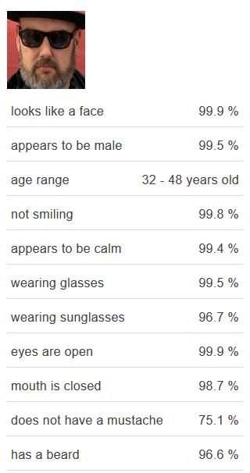
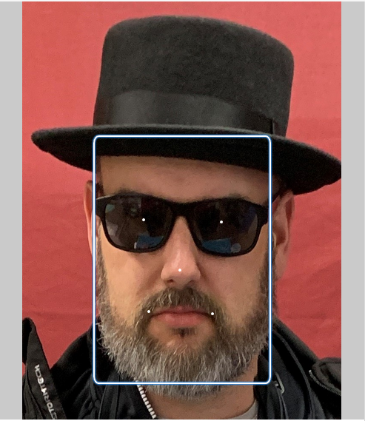
Face detection
Bounding box
Attributes
Emotions
Facial landmarks
Quality
Pose
Confidence score
Notes:
Facial detection uses a model that was tuned to perform predictions specifically for detecting faces and facial features, including:
Bounding box – The coordinates of the bounding box that surrounds the face.
Confidence – The level of confidence that the bounding box contains a face.
Facial landmarks – An array of facial landmarks. For each landmark (such as the left eye, right eye, and mouth), the response provides the x and y coordinates.
Facial attributes – A set of facial attributes, such as whether the face has a beard. For each attribute, the response provides a value. The value can be of different types, such as a Boolean type (whether a person is wearing sunglasses) or a string (whether the person is male or female). For most attributes, the response also provides a confidence score in the detected value for the attribute.
Quality – Describes the brightness and the sharpness of the face.
Pose – Describes the rotation of the face inside the image.
Emotions – A set of emotions with confidence in the analysis.
Again, confidence is a feature here, and it is provided for each feature that was detected. The feature prediction is based only on visual observation.

Slide 24
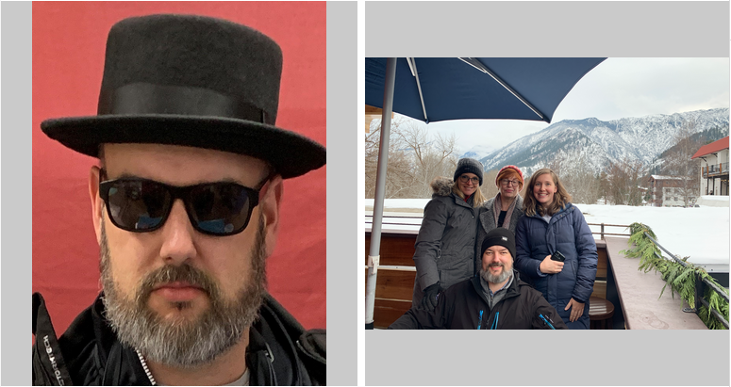
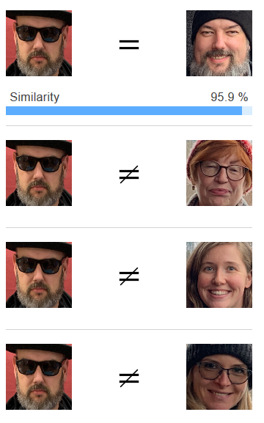
Using facial recognition
Compare source with target
Face match –
Bounding box and confidence
Similarity score
Facial landmark locations
Source face information –
Bounding box and confidence
Facial landmarks
Unmatched face –
Bounding box and confidence
Facial landmarks
Notes:
With Amazon Rekognition, you can compare two images to determine if they contain the same person. Comparisons require both a source and target image. The results will include all the faces that were found, and they include information about matching and non-matching faces. Again, confidence scores indicate how likely each prediction is.

Slide 25

Searching for known faces
Must train the model
Use images with target faces
Perform facial recognition
Store facial metadata
{
"FaceModelVersion": "string",
"Faces": [
{
"BoundingBox": {
"Height": number,
"Left": number,
"Top": number,
"Width": number
},
"Confidence": number,
"ExternalImageId": "string",
"FaceId": "string",
"ImageId": "string"
}
],
"NextToken": "string"
}
Response
Initialize
Create collection
Perform facial
recognition
Collection
Index faces
Amazon Rekognition
Multidimensional facial features
Metadata
Notes:
Amazon Rekognition can also search for known faces. To use this feature, you must train the model by providing a collection of images to use. After you train the model, you can then detect those people in images that you provide.
To find known faces, you must first create a collection and then add faces to the collection. Amazon Rekognition will perform facial recognition on the images that you provide and will return typical information like the bounding box coordinates or confidence score.
To associate faces with an image, you must specify an image ID in the ExternalImageId request parameter. This could be the file name of the image or another ID that you create.

Slide 26
Searching for Known Faces
SearchFacesByImage
Collection
Multidimensional facial features
Metadata
Amazon Rekognition
Response
{ "FaceMatches": [ {
"Face": {
"BoundingBox": { "Height": 0.0633333027, "Left": 0.171851992, "Top": 0.73666697, "Width": 0.1106169968 },
"Confidence": 100,
"ExternalImageId": "input.jpg",
"FaceId": "578e2e1b-d0b0-493c-aa39-ba476a421a34",
"ImageId": "9ba38e68-35b6-5509-9d2e-fcffa75d1653" },
"Similarity": 99.9764175415039 } ],
"FaceModelVersion": "3.0",
"SearchedFaceBoundingBox": { "Height": 0.063333332, "Left": 0.171851858, "Top": 0.73666667, "Width": 0.11061728 },
"SearchedFaceConfidence": 99.99999237060547 }
Notes:
After you create your collection, you can then use the SearchFacesByImage operation to search for faces from the collection.
The returned data contains an array of all faces that matched. The information includes bounding boxes, confidence scores, and the ExternalImageId value (which you can then use to link back to the source image).

Slide 27
Guidelines
Facial detection
Bounding box, attributes, emotions, landmarks, quality, pose
Confidence score
Detection is based on image data
Gender based on image, not identity
Emotions are inferred from physical appearance
You can use the appropriate confidence score for your use case
Facial recognition should never be used in a way that violates an individual’s rights, including the right to privacy, or makes autonomous decisions for scenarios that require analysis by a human*
Notes:
When Amazon Rekognition detects a human face, it captures a bounding box that indicates where the face was found in the video. It also can detect attributes such as position of the eyes, nose, and mouth. It can detect emotion, quality of the detection, and any landmarks that might appear.
All these items will have an associated confidence score. A higher score indicates that the model has greater confidence about the detection.
Gender is inferred from the image. It is not inferred from identity. Similarly, emotion is also determined based on the image and it might not reflect the subject’s actual emotional state.
* How should I apply facial recognition responsibly?
Facial recognition should never be used in a way that violates an individual’s rights, including the right to privacy. It should also never be used to make autonomous decisions for scenarios that require analysis by a human. For example, consider a bank that uses tools like Amazon Rekognition to verify their customers’ identity in a financial application. The bank should always clearly disclose their use of the technology and ask the customer for their approval of the terms and conditions. With regard to public safety and law enforcement, we think that governments are free to work with law enforcement agencies to develop acceptable use policies for facial recognition technologies that both protect the rights of citizens and enable law enforcement to protect the public’s safety.
In all public safety and law enforcement scenarios, technology like Amazon Rekognition should only be used to narrow the field of potential matches. The responses from Amazon Rekognition enable officials to quickly get a set of potential faces for further human analysis. Given the seriousness of public-safety use cases, human judgment is needed to augment facial recognition, and facial recognition software should not be used autonomously.
For more information, refer to the AWS webpage: https://aws.amazon.com/rekognition/the-facts-on-facial-recognition-with-artificial-intelligence/

Slide 28
Demonstration: Introducing Amazon Rekognition
Notes:
Your instructor will now either demonstrate Amazon Rekognition or provide you with access to a recorded demonstration.

Slide 29



Working with stored videos
Process:
Start detection
People, faces, labels, celebrities, text, inappropriate content
Monitor Amazon Simple Queue Service (Amazon SQS) queue for completion
Get detection results
H.264
MOV/MPEG-4
Max 10 GB
Start detection
Existing video
Topic
Amazon Rekognition
Monitor SQS
Client
Queue
Get detection results
Notes:
You can perform video processing on both stored videos and video streams.
Stored videos should be stored in an S3 bucket.
Each type of detection has its own Start operation. You can search for people, faces, labels, celebrities, text, and inappropriate content.
Amazon Rekognition publishes completion status to an Amazon Simple Notification Service (Amazon SNS) topic. Then, Amazon SNS can route these messages to subscribers. It is a best practice to route messages to an Amazon Simple Queue Service (Amazon SQS) message queue for durability. Your application should monitor the SQS queue for completion.
Each Start operation has a corresponding Get operation for retrieving the results.
People: StartPersonTracking / GetPersonTracking
Faces: StartFaceDetection / GetFaceDetection
Labels: StartLabelDetection / GetLabelDetection
Celebrities: StartCelebrityRecognition / GetCelebrityRecognition
Explicit or suggestive adult content: StartContentModeration / GetContentModeration
Calling Get Detection Results returns an array of labels that contain information about any labels that were found in the video. The label information includes the same labels as image detection, along with a timestamp of where the label was detected in milliseconds from the start of the video.

Slide 30
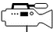


Working with streaming videos
Application process:
Stream video to Amazon Kinesis Video Streams
Connect Amazon Rekognition Video stream processor
Read analysis from the Amazon Kinesis data stream
Amazon Kinesis
Video Streams
Amazon Rekognition
Client
Amazon Kinesis
Data Streams
Notes:
You can use Amazon Rekognition Video to detect and recognize faces in streaming video. A typical use case is when you want to detect a known face in a video stream. Amazon Rekognition Video uses Amazon Kinesis Video Streams to receive and process a video stream. The analysis results are output from Amazon Rekognition Video to a Kinesis data stream and are then read by your client application. Amazon Rekognition Video provides a stream processor (CreateStreamProcessor) that you can use to start and manage the analysis of streaming video.
To use Amazon Rekognition Video with streaming video, your application must implement the following resources:
A Kinesis video stream for sending streaming video to Amazon Rekognition Video
An Amazon Rekognition Video stream processor to manage the analysis of the streaming video
A Kinesis data stream consumer to read the analysis results that Amazon Rekognition Video sends to the Kinesis data stream
To find a face, you must create a collection. This process is the same as creating a collection when you work with images.
Amazon Rekognition Video places a JSON frame record for each analyzed frame into the Kinesis output stream. Amazon Rekognition Video doesn't analyze every frame that's passed to it through the Kinesis video stream.
A frame record that's sent to a Kinesis data stream contains information about which Kinesis video stream fragment the frame is in, where the frame is in the fragment, and faces that are recognized in the frame. It also includes status information for the stream processor.

Slide 31
Section 2 Key Takeaways
You can use Amazon Rekognition for image and video analysis that uses proven, highly scalable, deep learning technology that doesn’t require machine learning expertise
Provides image and video detection of faces, sentiment, text, unsafe content, and library search
Is integrated into other AWS services
Notes:
Some key takeaways from this section of the module include:
Amazon Rekognition is a computer vision service that is based on deep learning. You can easily add image and video analysis to your applications,
Amazon Rekognition provides image and video detection of faces, sentiment, text, unsafe content, and library search.
Amazon Rekognition is integrated into other AWS services.

Slide 32
Section 3: Preparing custom datasets for computer vision
Module 5: Introducing Computer Vision
Notes:
Introducing Section 3: Preparing custom datasets for computer vision.

Slide 33
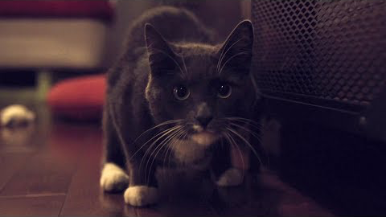
Video analysis, labels, Ben, and Metric
AWS DeepLens Powered Cat Flap
Notes:
You can watch these videos:
AWS DeepLens Powered Cat Flap
Ben Hamm’s Ignite presentation about the system that he created

Slide 34

Models need training on domain
Wood | 97%
Canvas | 88.7%
Text | 84.7%
Envelope | 71.7%
Greeting Card | 70.4%
Mail | 70.4%
Hardwood | 60.6%
Plywood | 60.4%
Paper | 57.7%
Advertisement | 55.8%
Poster | 55.8%
Art | 55.6%
Notes:
One challenge of using a pre-built model is that it will only find images that it was trained to find. Though Amazon Rekognition was trained with tens of millions of images, it can’t detect objects that it wasn’t trained on.
For example, consider the eight of hearts playing card. If you run this card through Amazon Rekognition, the results show various attributes. However, none of the labels are playing card or eight of hearts. If you want Amazon Rekognition to detect images in your problem domain, you must train the model with your images.
In this section, you will learn how to train Amazon Rekognition with images from your problem domain. Though you will learn about Amazon Rekognition specifically, the process will be similar if you use other pre-trained models.

Slide 35
Amazon Rekognition Custom Labels
Use for –
Search for logos
Identify products
Identify machine parts
Distinguish between healthy and infected plants
Almost all vision solutions start with an existing model
Benefits –
Simplified data labeling
Automated machine learning
Simplified model evaluation, inference, and feedback
Notes:
As with other machine learning processes, you must train Amazon Rekognition to recognize scenes and objects that are in a domain. Thus, you need a training dataset and a test dataset that contains labeled images. Amazon Rekognition Custom Labels can be helpful for these tasks.
You can use Amazon Rekognition Custom Labels to find objects and scenes that are unique to your business needs. For example, you can use it to classify images (image-level predictions) or detect images (object-level or bounding-box-level predictions). For example, if you want to identify specific machine parts, such as a turbocharger or a torque converter, you could collect pictures of each part and use them to train a model.
Many machine learning problems today can be solved by training existing models. Training a computer vision algorithm to recognize images requires a large input dataset, which is impractical for most organizations.
You can use an existing model or a managed service like Amazon Rekognition Custom Labels to:
Simplify data labeling – Amazon Rekognition Custom Labels provides a UI for labeling images, including defining bounding boxes.
Provide automated machine learning – Amazon Rekognition Custom Labels includes automated machine learning capabilities that handle the ML process for you. When you provide training images, Amazon Rekognition Custom Labels can automatically load and inspect the data, select the correct machine learning algorithms, train a model, and provide model performance metrics.
Provide simplified model evaluation, inference, and feedback – You evaluate your custom model’s performance on your test set. For every image in the test set, you can see the side-by-side comparison of the model’s prediction versus the label that it assigned. You can also review detailed performance metrics. You can start using your model immediately for image analysis, or you can iterate and retrain new versions with more images to improve performance.
After you start using your model, you can track your predictions, correct any mistakes, and use the feedback data to retrain new model versions and improve performance.

Slide 36






Custom labeling process
1: Collect images
2: Create training dataset
3: Create test dataset
4: Train the model
5: Evaluate
6: Use Model
Notes:
The diagram shows a typical process for training a computer vision model, which includes the Amazon Rekognition Custom Labels feature.
Step 1 – Collect images that contain the objects or scenes you want to find.
Step 2 – Upload and label images from your computer or Amazon S3, or import an Amazon SageMaker Ground Truth .manifest file for already labeled images.
Step 3 – Create a dataset to evaluate your model’s performance, select an existing dataset, or split your training dataset for testing.
Step 4 - Train your custom model by using your training datasets. The best ML techniques will automatically be selected.
Step 5 - Evaluate your model performance on your test dataset. Improve your model by adding images to the training dataset.
Step 6 - Use your customer model to analyze images with an API operation.

Slide 37
Step 1: Collect images
1: Collect images
2: Create training dataset
3: Create test dataset
4: Train the model
5: Evaluate
6: Use Model
Typically use a few hundred images
Build domain-specific models
Use 10 PNG or JPEG images per label
Use images similar to the images that you want to detect
Notes:
The process of developing a custom model to analyze images requires time, expertise, and resources. It often takes months to complete. Additionally, it can require thousands or tens of thousands of hand-labeled images to provide the model with enough data to make decisions accurately. It can take months to generate and gather this data, and it can require large teams of labelers to prepare it for use in machine learning.
Amazon Rekognition Custom Labels builds on the existing capabilities of Amazon Rekognition, which are already trained on tens of millions of images across many categories. Instead of thousands of images, you can upload a small set of training images that are specific to your use case. You typically use a few hundred images or less. You can upload training images by using the console. If your images are already labeled, Amazon Rekognition Custom Labels can begin training a model in a short time. If not, you can label the images directly in the labeling interface, or you can use Amazon SageMaker Ground Truth to label them for you.
Amazon Rekognition Custom Labels works best when you use different models for different domains. For example, if you must detect machine parts and plant health, you would use two different models.
Images that you select for training should be similar to the images that will be used for inference. You should use images that use various lighting conditions, backgrounds, and resolutions ideally that mirror images that you would want to perform detection on. If you can use the same source, as you would use in production, that works best.
The documentation includes additional guidelines on image type (JPEG or PNG), image size, resolution, and other properties.

Slide 38
Step 2: Create training dataset
1: Collect images
2: Create training dataset
3: Create test dataset
4: Train the model
5: Evaluate
6: Use Model
Dataset: Data about images, labels, and bounding box
Create at least two labels
Label the images by using the console or Amazon SageMaker Ground Truth
Notes:
Datasets contain information about images, labels, and bounding boxes that is needed to train and test an Amazon Rekognition Custom Labels model.
You can use images from Amazon S3, or upload them from your computer to Amazon S3 as part of the process.
To train a model, your dataset should have at least two labels, with at least 10 images per label. Each image in your dataset must be labeled. You can use the Amazon Rekognition Custom Labels console or use Amazon SageMaker Ground Truth.
Amazon SageMaker Ground Truth enables you to use workers from your own workforce, Amazon Mechanical Turk, or a vendor company to label the images. You can import the results of these labeling efforts into an Amazon Rekognition Custom Labels dataset.
If you have images that are already labeled, you must convert the labels into an Amazon SageMaker Ground Truth manifest file. To learn more details about the format, refer to https://docs.aws.amazon.com/rekognition/latest/customlabels-dg/cd-manifest-files.html

Slide 39

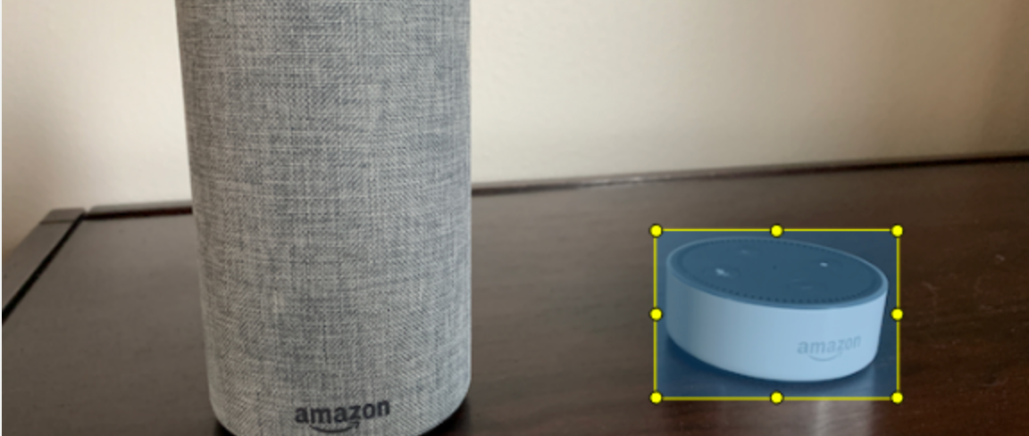
Image-level versus object-level labels
Scenes and concepts
Objects with bounding boxes
Label: beach
Label: Echo Dot
Notes:
To train an Amazon Rekognition Custom Labels model, your images must be labeled. A label indicates that an image contains an object, scene, or concept.
A dataset needs at least two defined labels. Each image must have at least one assigned label that identifies the object, scene, or concept in the image.
Scenes and concepts
You can apply labels to an image as a whole. These labels are known as image-level labels. They are useful for identifying scenes or concepts that you want to detect. For example, the following image shows a beach scene from Ko Olina from the island of Oahu in the US state of Hawaii. To train a model to detect beaches, you would add a beach label that applies to the entire image.
Objects with bounding boxes
Labels can be applied to areas of an image that contain an object that you want to detect. For example, if you want your model to detect Amazon Echo devices, it must identify the types of Echo Devices that are in an image. The model needs information about where the devices are in the image, and a corresponding label that identifies the type of the device. This information is known as localization information. The location of the device is expressed as a bounding box. The example Objects with bounding boxes image shows a bounding box that surrounds an Amazon Echo Dot. The image also contains an Amazon Echo without a bounding box.

Slide 40
Images need labels
{
"source-ref": "s3://b/…/img_2783.jpg",
"small_beach": 1,
"small_beach-metadata": {
"confidence": 1,
"job-name": "labeling-job/small_beach",
"class-name": “Beach",
"human-annotated": "yes",
"creation-date": "2020-03-02T20:42:03.525Z",
"type": "groundtruth/image-classification"
}
}
Notes:
The manifest file for an image level label will typically contain the label, or class-name, along with some metadata about how the image was labeled.

Slide 41

Objects need bounding boxes
"small_BB": { "annotations": [
{ "left": 186,"top": 125,”width": 346,"height": 580,
"annotationType": "bounding-box", "id": 5,"class_id": 0},
{ "left": 732,"top": 445,"width": 270,"height": 192,
"annotationType": "bounding-box", "id": 6,"class_id": 1}],
"image_size": [
{ "width": 1152,"height": 864,"depth": 3 }]},
"small_BB-metadata": {
"job-name": "labeling-job/small_BB",
"class-map": { "0": "Echo", "1": "Echo dot“ },
"human-annotated": "yes",
"objects": [ {"confidence": 1}, {"confidence": 1}],
"creation-date": "2020-03-02T20:42:25.930Z",
"type": "groundtruth/object-detection"
Notes:
For object detection, the manifest will contain information about each labeled image. The bounding box identifies where the object is in the image, along with the label that bounding box belongs to.

Slide 42
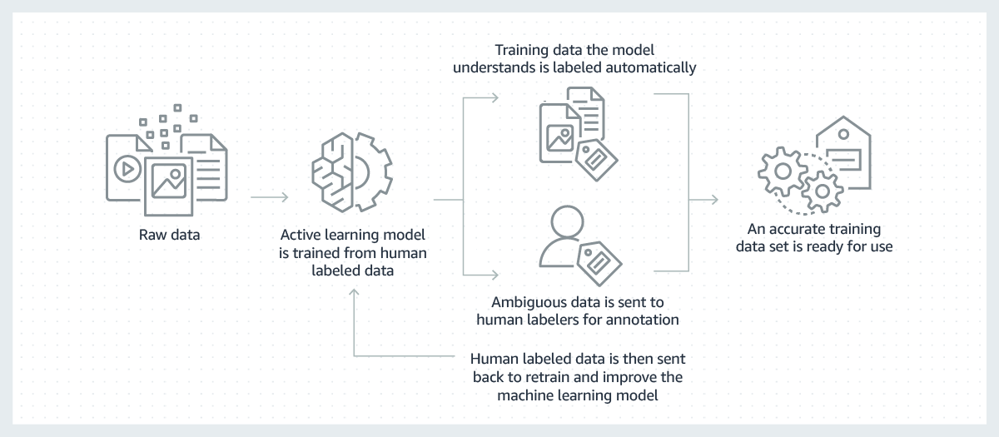
Amazon SageMaker Ground Truth
Notes:
Amazon SageMaker Ground Truth enables you to build high-quality training datasets for your machine learning models. As mentioned earlier, you can use workers from Amazon Mechanical Turk, a vendor company, or an internal workforce with machine learning to create a labeled dataset. You can use the labeled dataset output from Ground Truth to train your own models. You can also use the labeled dataset for Amazon Rekognition Custom Labels.
Ground Truth can use active learning to automate the labeling of your input data. Active learning is a machine learning technique that identifies data that should be labeled by your workers. In Ground Truth, this functionality is called automated data labeling. Automated data labeling can reduce the cost and time that it takes to label your dataset compared to using only humans. When you use automated labeling, you incur Amazon SageMaker training and inference costs.
We recommend using automated data labeling on large datasets. The neural networks that are used with active learning need a large amount of data for every new dataset. Typically, the potential for highly accurate predictions increases when more data is provided. Data will only be automatically labeled if the neural network that is used in the automated labeling model can achieve an acceptably high level of accuracy. Data will be automatically labeled only if the neural network that’s used in the automated labeling model can achieve an acceptably high level of accuracy. With a larger dataset, the neural network has more potential to achieve high-enough level accuracy for automatic labeling. Automated data labeling is most appropriate when you have thousands of data objects. The minimum number of objects allowed for automated data labeling is 1,250. However, we strongly suggest providing a minimum of 5,000 objects.
You enable automated data labeling when you create a labeling job. This process outlines how it works:
When Ground Truth starts an automated data labeling job, it selects a random sample of input data (objects) and sends it to human workers.
When the labeled data is returned, Ground Truth uses this data (the validation data) to validate the models that were trained for automated data labeling.
Ground Truth runs a batch transform job by using the validated model for inference on the validation data. Batch inference produces a confidence score and quality metric for each object in the validation data.
The automated labeling component uses these quality metrics and confidence scores to create a confidence score threshold that is designed to support label quality.
Ground Truth runs a batch transform job on the unlabeled data in the dataset by using the same validated model for inference. This job will produce a confidence score for each object.
The Ground Truth automated labeling component determines if the confidence score for each object (which was produced in step 5) meets the required threshold (which was determined in step 4). If the confidence score meets the threshold, the expected quality of automatic labeling exceeds the requested level of accuracy. That object is then considered to be automatically labeled.
Step 6 produces a dataset of unlabeled data with confidence scores. Ground Truth selects data points with low confidence scores from this dataset, and sends them to human workers for additional labeling.
Ground Truth uses the existing human-labeled data and the additional human-labeled data to train a new model.
The process is repeated until the dataset is fully labeled or until another stopping condition is met. For example, automatic labeling can stop when you meet your budget for human annotation.

Slide 43
Step 3: Create test dataset
1: Collect images
2: Create training dataset
3: Create test dataset
4: Train the model
5: Evaluate
6: Use Model
Training set
Testing set
0%
80%
100%
Notes:
The final step before you train your model is to identify a test dataset. You will use this test dataset to validate and evaluate the model’s performance by performing an inference on the images that are in the test dataset. You will then compare the results with the labeling information that is in the training dataset.
You can create your own test dataset. Alternatively, you can use Amazon Rekognition Custom Labels to split your training dataset into two datasets by using an 80/20 split. This split means that 80 percent of the data is used for training and 20 percent of the data is used for testing.

Slide 44
Step 4: Train the model
1: Collect images
2: Create training dataset
3: Create test dataset
4: Train the model
5: Evaluate
6: Use Model
Notes:
After you define the training and test datasets, Amazon Rekognition Custom Labels can automatically train the model for you. Amazon Rekognition Custom Labels automatically loads and inspects the data, selects the correct machine learning algorithms, trains a model, and provides model performance metrics.
You are charged for the amount of time that a model takes to train. A dataset that contains more images and labels will take longer to train.

Slide 45
Step 5: Evaluate - Metrics
1: Collect Images
2: Create training dataset
3: Create test dataset
4: Train the model
5: Evaluate
6: Use Model
Evaluate model performance
Metrics
Precision
Recall
Overall model performance
Confusion Matrix
 |  | Actual
Predicted |  | Cat | Not a Cat
 | Cat | TP | FP
 | Not a Cat | FN | TN
Notes:
When training is complete, you evaluate the performance of the model.
During testing, Amazon Rekognition Custom Labels predicts if a test image contains a custom label. The confidence score is a value that quantifies the certainty of the model’s prediction.
Since this is a classification problem, the results can be mapped to a confusion matrix:
True positive (TP) – The Amazon Rekognition Custom Labels model correctly predicts the presence of the custom label in the test image. That is, the predicted label is also a ground truth label for that image. For example, Amazon Rekognition Custom Labels correctly returns a cat label when a cat is present in an image.
False positive (FP) – The Amazon Rekognition Custom Labels model incorrectly predicts the presence of a custom label in a test image. That is, the predicted label isn’t a ground truth label for the image. For example, Amazon Rekognition Custom Labels returns a cat label, but there is no cat label in the ground truth for that image.
False negative (FN) – The Amazon Rekognition Custom Labels model doesn't predict that a custom label is present in the image, but the ground truth for that image includes this label. For example, Amazon Rekognition Custom Labels doesn’t return a cat custom label for an image that contains a cat.
True negative (TN) – The Amazon Rekognition Custom Labels model correctly predicts that a custom label isn't present in the test image. For example, Amazon Rekognition Custom Labels doesn’t return a cat label for an image that doesn’t contain a cat.
The console provides access to true positive, false positive, and false negative values for each image in your test dataset.
These prediction results are used to calculate the various metrics for each label and an aggregate of metrics for your entire test set. The same definitions apply to predictions that the model makes at the bounding-box level. With bounding boxes, all metrics are calculated over each bounding box (whether prediction or ground truth) in each test image.
To help you, Amazon Rekognition Custom Labels provides summary metrics and evaluation metrics for each label.
Precision metrics
Amazon Rekognition Custom Labels provides precision metrics for each label and an average precision metric for the entire test dataset.
Precision is the proportion of positive results that were correctly classified
Recall metrics
Amazon Rekognition Custom Labels provides average recall metrics for each label and an average recall metric for the entire test dataset.
Recall is the fraction of your test set labels that were correctly classified. In our example that would be how many cats were correctly classified.
Overall model performance
Amazon Rekognition Custom Labels provides an average model performance score for each label and an average model performance score for the entire test dataset. The F1 Score combines precision and recall together to give you just one number to quantify the overall performance of a particular ML algorithm. You should look at using F1 score when you have a class imbalance but want to preserve the equality between precision and sensitivity. A higher value means better model performance for both recall and precision.
If you're satisfied with the accuracy of your model, you can start to use it.

Slide 46
Step 5: Evaluate – Improve
1: Collect Images
2: Create training dataset
3: Create test dataset
4: Train the model
5: Evaluate
6: Use Model
Data
Reducing false positives (better precision)
Adjust the confidence threshold to improve precision
Add additional classes as labels for training
Reducing false negatives (better recall)
Lower the confidence threshold to improve recall
Use better data or more precise classes (labels) for training
Notes:
Data
In general, you can improve the quality of your model with larger quantities of better-quality data. Use training images that clearly show the object or scene and don’t include many things that you are not interested in. For bounding boxes around objects, use training images that show the object fully visible and not hidden by other objects.
Make sure that your training and test datasets match the type of images that you will eventually run inference on. For objects, where you have just a few training examples (like logos), you should provide bounding boxes around the logo in your test images. These images represent the scenarios that you want to localize the object in.
Reducing false positives (better precision)
First, check if increasing the confidence threshold enables you to keep the correct predictions while eliminating false positives. Increasing the confidence threshold eventually results in diminishing gains because of the tradeoff between precision and recall for a given model.
You might see one or more of your custom labels of interest (A) consistently get confused with the same class of objects (but not a label that you're interested in) (B). To help, add B as an object class as a label to your training dataset (along with the images that you got the false positive on). Effectively, you're helping the model learn to predict B and not A through the new training images.
You might find that the model is confused between two of your custom labels (A and B)—the test image with label A is predicted as having label B and vice versa. In this case, first check for mislabeled images in your training and test sets. Also, adding more training images that reflect this confusion will help a retrained model learn to better discriminate between A and B.
Reducing false negatives (better recall)
Lower the confidence threshold to improve recall.
Use better examples to model the variety of both the object and the images in which they appear.
Split your label into two classes that are easier to learn. For example, instead of good cookies and bad cookies, you might want good cookies, burnt cookies, and broken cookies to help the model better learn each unique concept.

Slide 47
Step 6: Use the model
1: Collect Images
2: Create training dataset
3: Create test dataset
4: Train the model
5: Evaluate
6: Use Model
aws rekognition detect-custom-labels --project-version-arn "model_arn"\
--image '{"S3Object":{"Bucket":"bucket","Name":"image"}}'\
--min-confidence 70
Returns array of custom labels:
Label
Bounding box for objects
Confidence
Notes:
If you are satisfied with the performance of your model, you can make it available for use by starting it from the console or by using code.
After the model is running, you can perform an inference by using the AWS CLI or the SDK.
When you call the API, you specify:
The Amazon Resource Name (ARN) of the Amazon Rekognition Custom Labels model that you want to use.
The image that you want the model to make a prediction with. You can provide an input image as an image byte array (base64-encoded image bytes) or as an Amazon S3 object.
Custom labels are returned in an array of Custom Label objects. Each custom label represents a single object, scene, or concept that is found in the image. A custom label includes:
A label for the object, scene, or concept that was found in the image.
A bounding box for objects that were found in the image. The bounding box coordinates show where the object is located on the source image. The coordinate values are a ratio of the overall image size.
The confidence that Amazon Rekognition Custom Labels has in the accuracy of the label and bounding box.
During training, a model calculates a threshold value that determines if a prediction for a label is true. By default, the DetectCustomLabels operation doesn't return labels with confidence value that is less than the model's calculated threshold value. To filter the labels that are returned, specify a value for MinConfidence that is greater than the model's calculated threshold. You can get the model's calculated threshold from the model's training results shown in the Amazon Rekognition Custom Labels console. To get all the labels regardless of confidence, specify a MinConfidence value of 0.
If you find that the confidence values returned by the DetectCustomLabels operation are too low, consider retraining the model. You can restrict the number of custom labels that are returned from the DetectCustomLabels operation by specifying the MaxResults input parameter. The returned results are sorted from the highest confidence to the lowest confidence.

Slide 48
Demonstration: Labeling Images with Amazon SageMaker Ground Truth
Notes:
Your instructor will now either demonstrate how to label images with Amazon SageMaker Ground Truth or provide you with access to a recorded demonstration.

Slide 49
Section 3 key takeaways
Models must be trained for the specific domain that you want to analyze
You can set custom labeling for the specific business case
Custom labeling workflow
You must label images and create bounding boxes for objects
You can use Amazon SageMaker Ground Truth to build training datasets for your models
Notes:
Some key takeaways from this section of the module include:
Models must be trained for the specific domain that you want to analyze
You can set custom labeling for the specific business case
Custom labeling workflow
You must label images and create bounding boxes for objects
You can use Amazon SageMaker Ground Truth to build training datasets for your models

Slide 50

Module 5 – Guided Lab: Facial Recognition
Notes:
You will now complete Module 5 – Guided Lab: Facial Recognition.

Slide 51
Module wrap-up
Module 5: Introducing Computer Vision
Notes:
It’s now time to review the module and wrap up with a knowledge check.

Slide 52
Module summary
In summary, in this module, you learned how to:
Describe use cases for computer vision
Describe the AWS managed machine learning (ML) services for image and video analysis
List the steps required to prepare a custom dataset for object detection
Describe how Amazon SageMaker Ground Truth can be used to prepare a custom dataset
Use Amazon Rekognition to perform facial detection
Notes:
In summary, in this module, you learned how to:
Use cases for computer vision
Describe the AWS managed machine learning (ML) services for image and video analysis
List the steps required to prepare a custom dataset for object detection
Describe how Amazon SageMaker Ground Truth can be used to prepare a custom dataset
Use Amazon Rekognition to perform facial detection

Slide 53
Complete the knowledge check
Notes:
It is now time to complete the knowledge check for this module.

Slide 54
Additional resources
What is Amazon Rekognition
Welcoming Amazon Rekognition Video: Deep-Learning Based Video Recognition
Classify a Large Number of Images with Amazon Rekognition and AWS Batch
Notes:
If you want to learn more about the topics covered in this module, you might find the following additional resources helpful:
What is Amazon Rekognition
Welcoming Amazon Rekognition Video: Deep-Learning Based Video Recognition
Classify a Large Number of Images with Amazon Rekognition and AWS Batch

Slide 55
Thank you
Notes:
Thank you for completing this module.

